Slide 1
EtherCAT SoE & FoE
Confidential 1

Slide 2
Overview
EtherCAT Communication Review
SoE
Sercos Basics
Rexroth IndraDrive
FoE
Resources
Confidential 2

Slide 3
EtherCAT Communication Review
Master/Slave communication model
Processing data “on the fly” for cyclic data
Mailbox communication for acyclic data
Synchronization – Distributed Clocks (DC)
EtherCAT State Machine

Slide 4
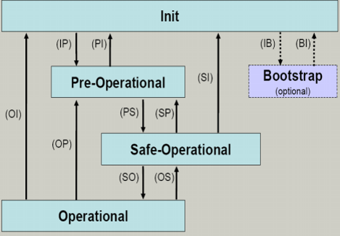
EtherCAT State Machine

Slide 5
SoE
SoE
Servo Drive Profile or Sercos over EtherCAT
Sercos
Serial real-time communication system
Cyclic data channel
Process data
AT(Amplifier Telegram)
MDT(Master Data Telegram)
Acyclic data channel
Read/Write parameters
Procedure commands

Slide 6
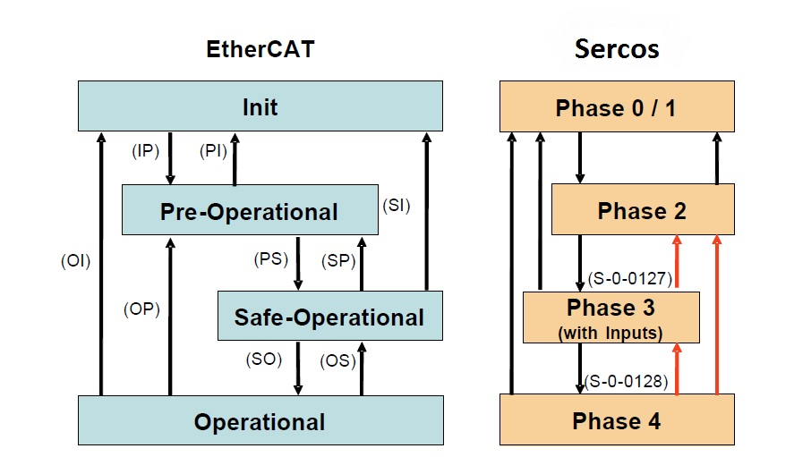
SoE Communication Phases

Slide 7
Sercos Parameters
All operation data are mapped to parameters
Parameters are used for:
Configuration
Triggering and controlling drive functions and commands
Exchanging data between master and slaves
Parameters can be identified via IDNs
Two types of parameters
Standard parameters (S parameters)
Product specific parameters (P parameters)

Slide 8
Sercos IDNs
Identification Numbers
Every IDN has an associated data block
A data block consists of seven elements
IDNumber
Name
Attribute
Unit
Minimum input
Maximum input
Operation data

Slide 9
Sercos Procedure Commands
Commands are used to activate and control complex functions or monitoring features
Drive control commands
Monitor commands
Administration commands
Each command is assigned to a parameter
Master can start, interrupt and clear a command

Slide 10
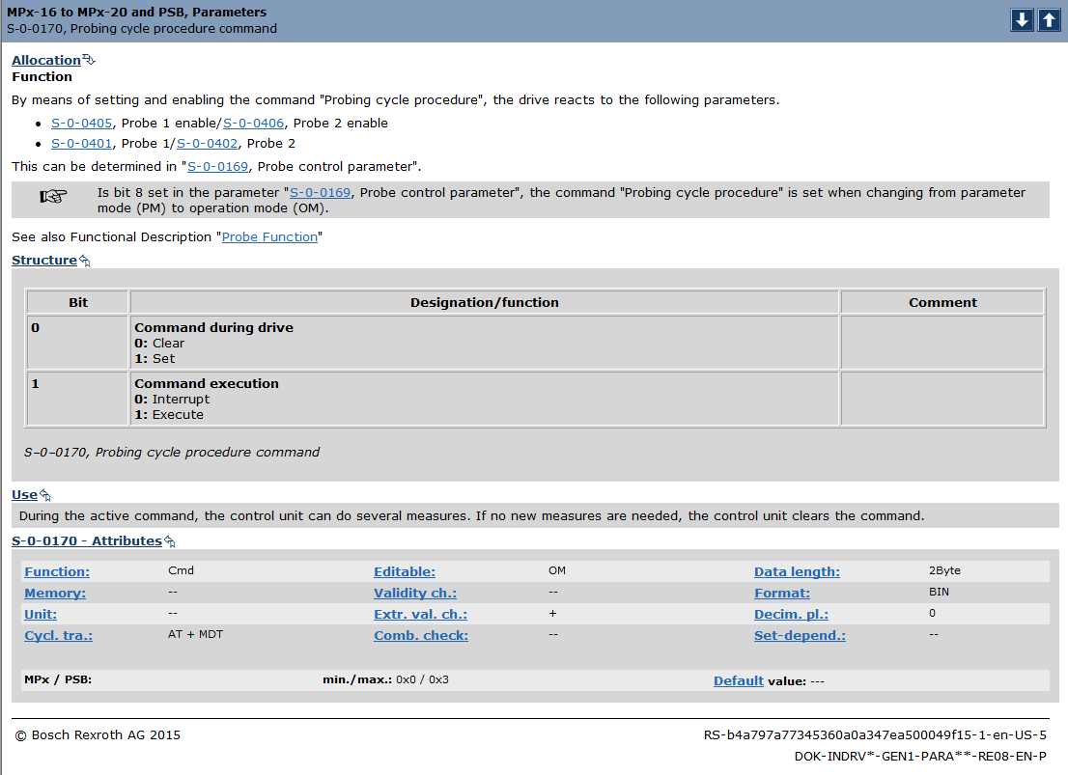
A Procedure Command Example

Slide 11
Device Internal State Machine
Parameter Mode(PM)
Allows writing to all drive parameters which are not password-protected
Operating Mode(OM)
Only allows writing to all drive parameters which can be changed in operation
Procedure commands
S-0-0420, C0400 Activate parameterization level
S-0-0422, C0200 Exit parameterization level

Slide 12
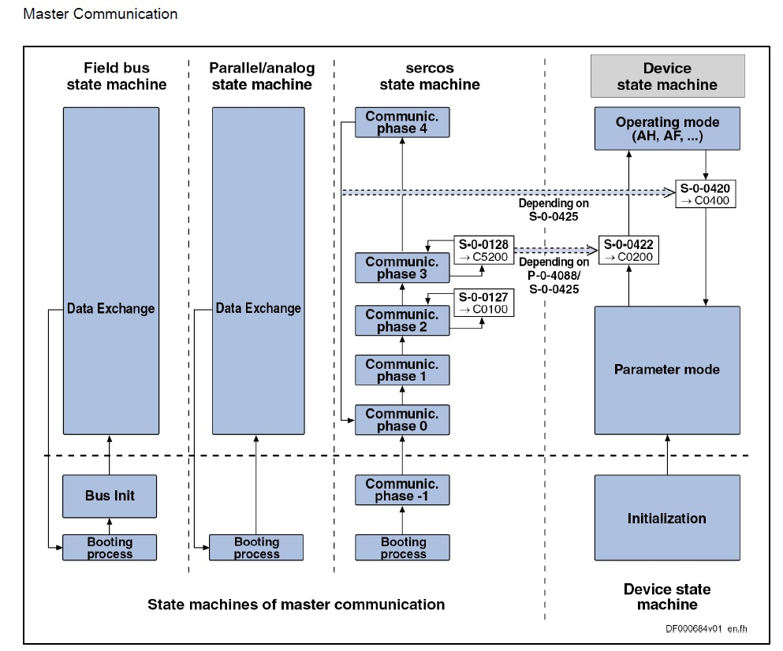
Communication and Device State Machines

Slide 13
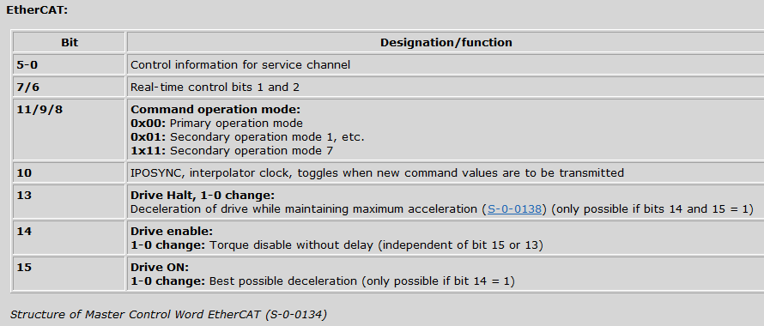
Control Word S-0-0134

Slide 14
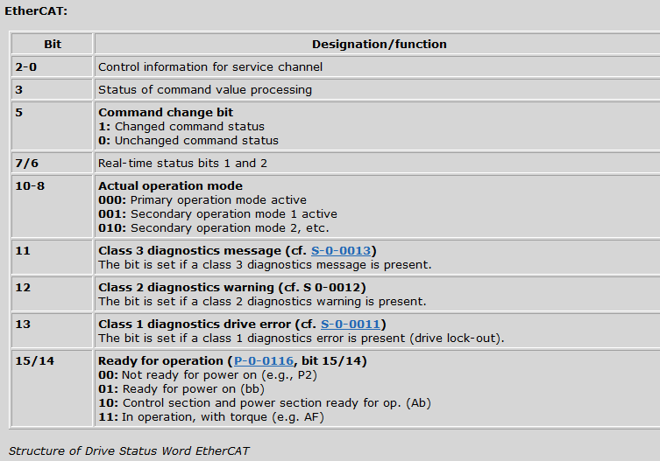
Status Word S-0-0135

Slide 15
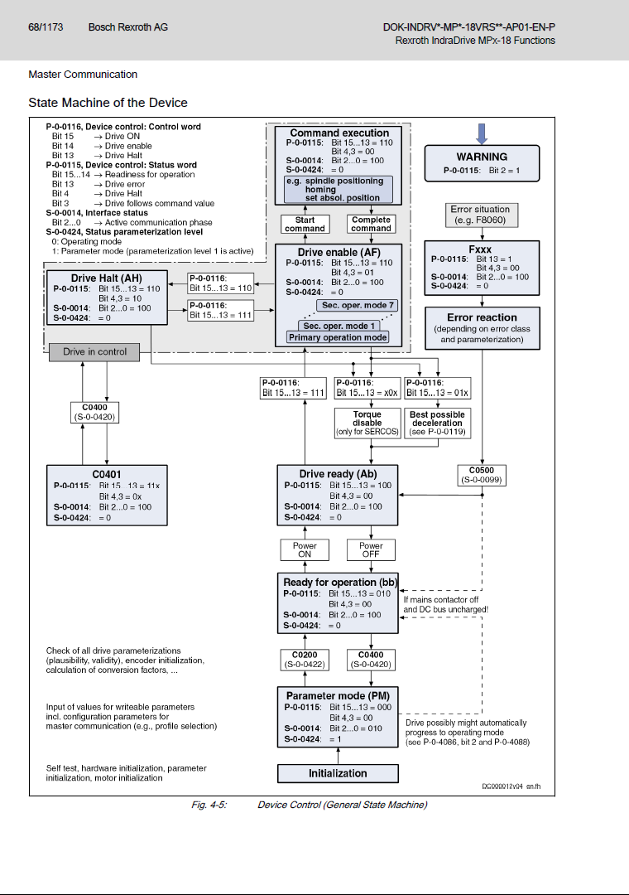
Device Control State Machine

Slide 16
Operation Modes
Supports up to 8 different operation modes
Primary operation mode
Secondary operation mode 1 to 7
Device control modes
Torque/force control
Velocity control
Position control
Synchronization modes

Slide 17
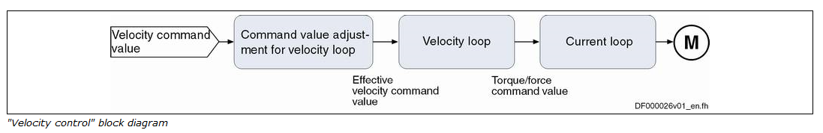
Velocity Control

Slide 18
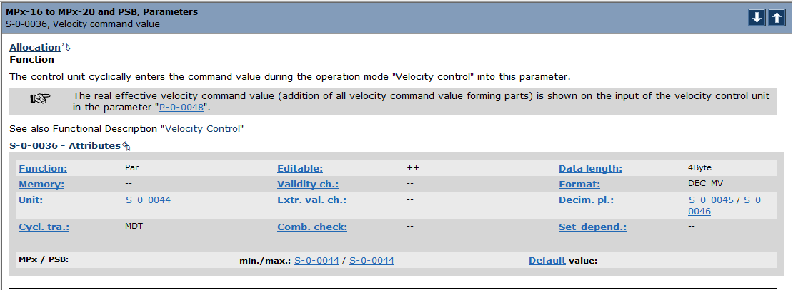
Velocity Command Value: S-0-0036

Slide 19
Rexroth IndraDrive
Hardware
Power section
Control section
Drive Firmware
MPB - Single-axis with basic performance and functionality
MPM - Double-axis drive with basic performance and functionality
Multiple communication protocols are supported
Licensed functional packages
SoE is our default communication protocol

Slide 20
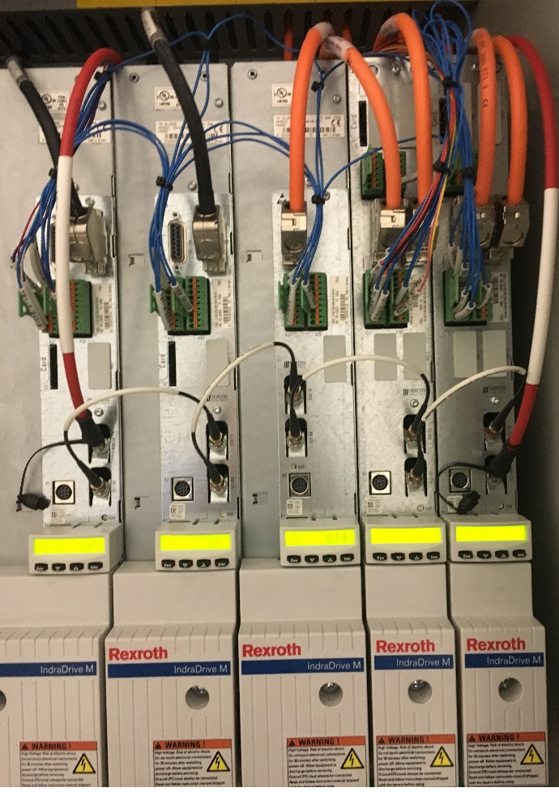
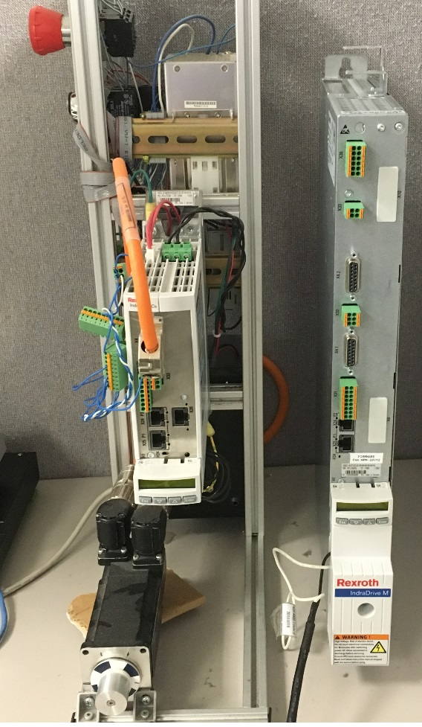
Rexroth IndraDrive

Slide 21
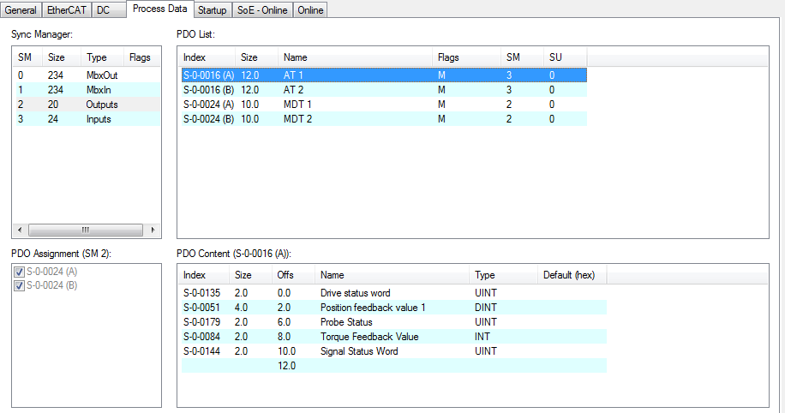
Rexroth IndraDrive MPM AT1 Mapping

Slide 22
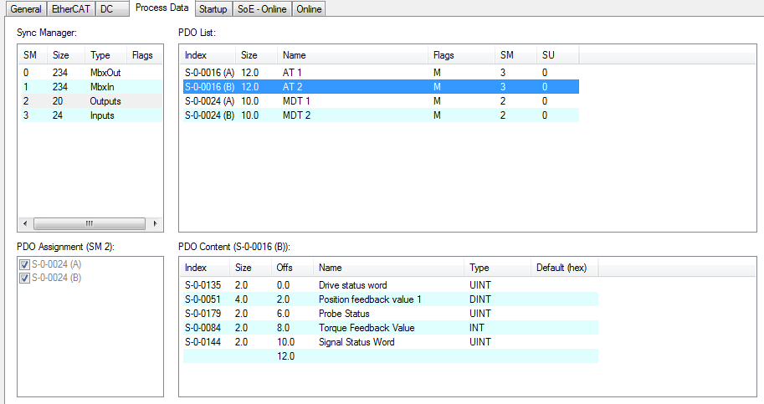
Rexroth IndraDrive MPM AT2 Mapping

Slide 23
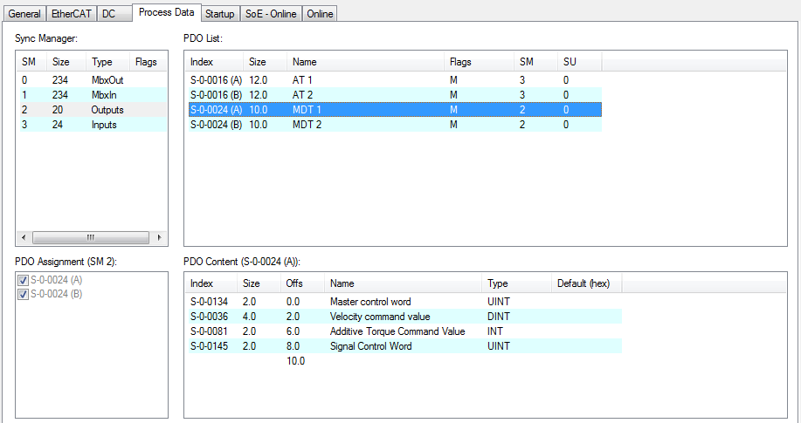
Rexroth IndraDrive MPM MDT1 Mapping

Slide 24
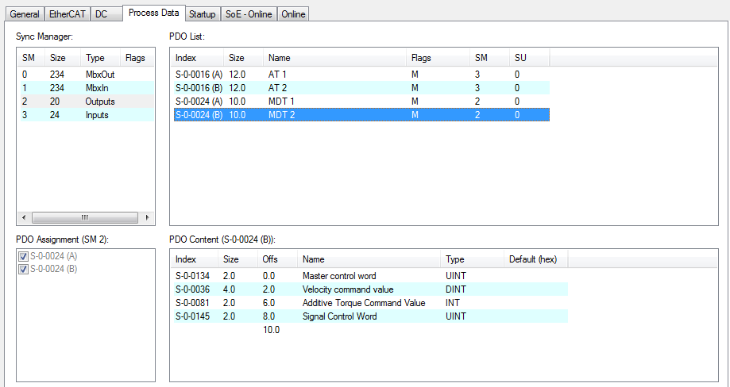
Rexroth IndraDrive MPM MDT2 Mapping

Slide 25
FoE
File Access over EtherCAT
FoE file download
Firmware
Drive parameter file
FoE file upload

Slide 26
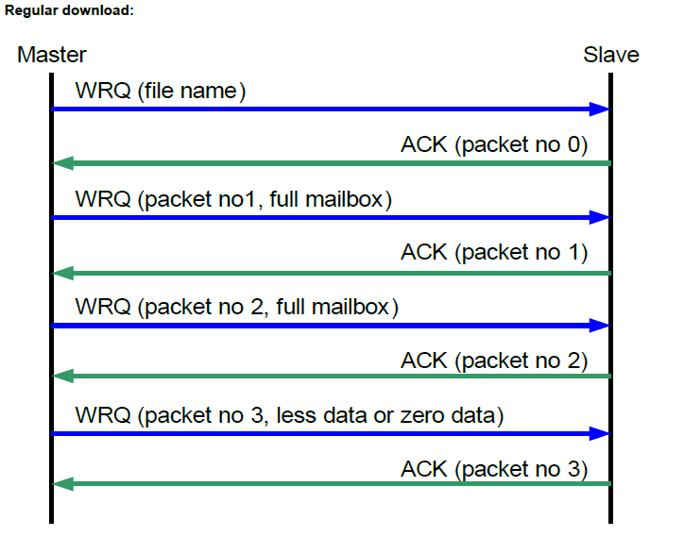
FoE File Download

Slide 27
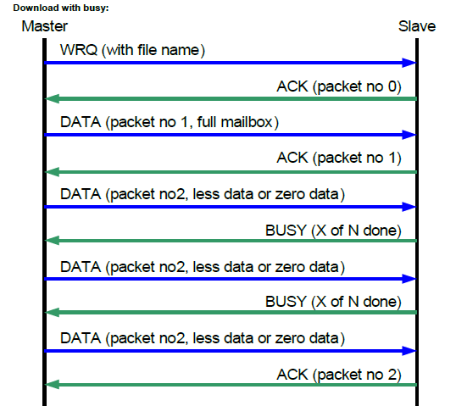
FoE File Download with Busy

Slide 28
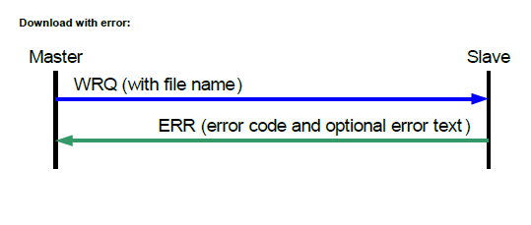
FoE Download with Error

Slide 29
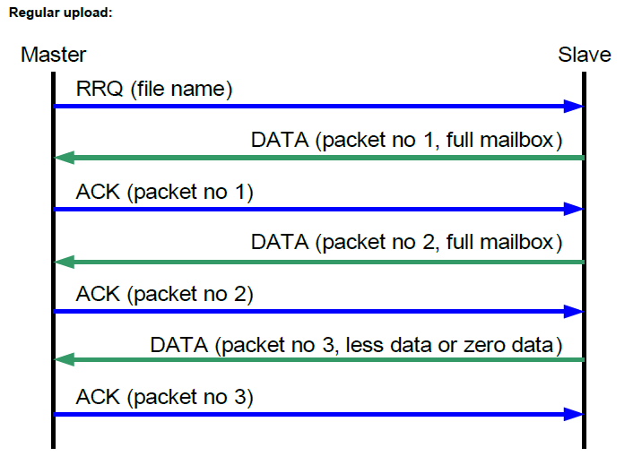
FoE File Upload

Slide 30
WinMax Servo Layer
SGDV
SD
RMB
Mitsubishi J4
RexIndraDrv
EcatIO
EcatMaster
Yaskawa
Rexroth
EcatServo
EcatSlave
EtherCAT Library
CoE
SoE
FoE
Master
Acontis Master Stack
Mailbox
Process Data
Distributed Clocks
Master
NIC Driver

Slide 31
EtherCAT Library Class Structure

Slide 32
Resources
Sercos
http://www.sercos.com/
User Manuals
Rexroth Indra Drive
Rexroth IndraWorks help manual
Developer’s Corner
RT\EtherCAT Technology

